Slide 1
BME 595 - FALL 2016
Michael Heinz
Oct 18, 2016
SPECTROGRAM BASICS & DEMO CODE

Slide 2
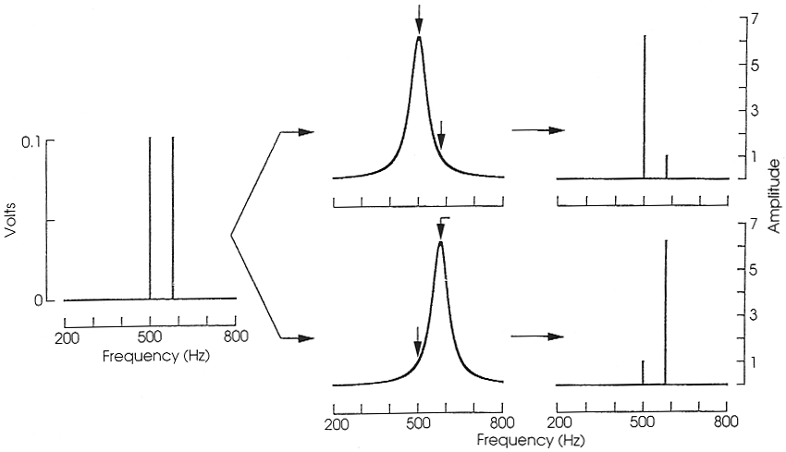
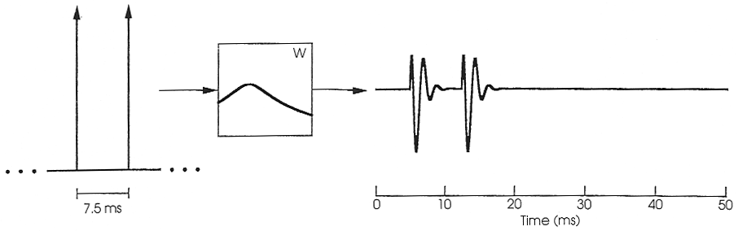
Bandwidth versus resolution: Summary
Narrow-band filters
  have fine resolution in frequency
  have poor resolution in time
Broad-band filters
  have poor resolution in frequency
  have fine resolution in time
In order to separate out two spectral components using band-pass filters, the bandwidths of the filters must be small relative to the spacing in frequency between them.
In order to separate out in time two impulses passing through a band-pass filter, the duration of the impulse response of the filter must be short relative to the duration between them.
Bandwidth | Time resolution | Frequency resolution | Impulse response
Narrow | Bad | Good | Long
Wide | Good | Bad | Short

Slide 3
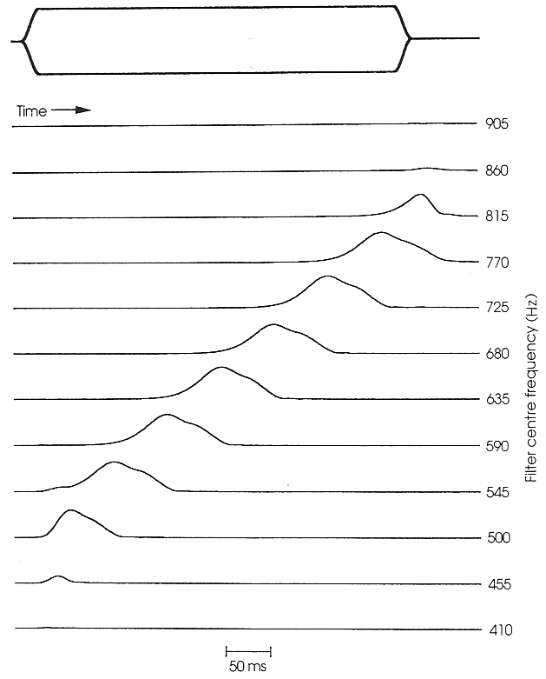
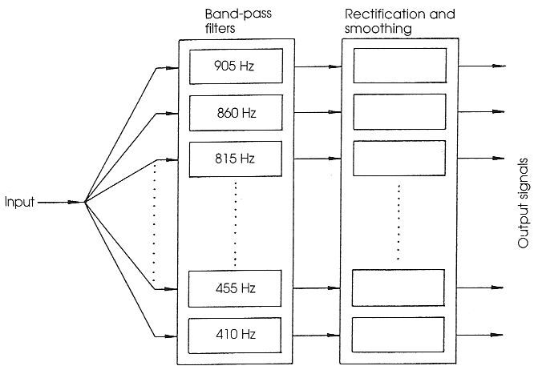
Filter bank shows the temporal evolution of spectrum
Input signal is processed by a set of BP filters, each followed by rectification and smoothing
Each individual filter has 45-Hz BW, and CFs range from 410 to 905 Hz
Whistle: 500-800 Hz
The set of time-varying outputs illustrate how the whistle’s spectrum changes over time

Slide 4
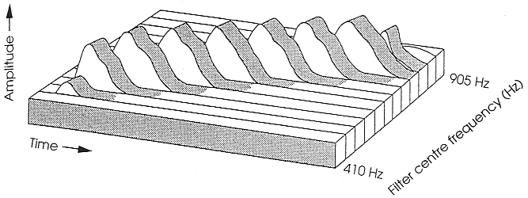
Spectrograms
Spectrograms are a convenient way to represent the spectral content of a signal as a function of time
Spectrograms represent three dimensions:
  Amplitude
  Frequency
  Time
Whistle: 500-800 Hz

Slide 5
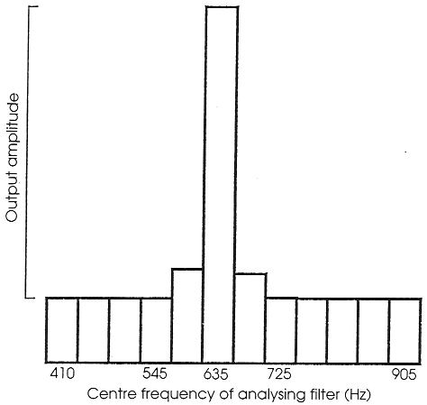
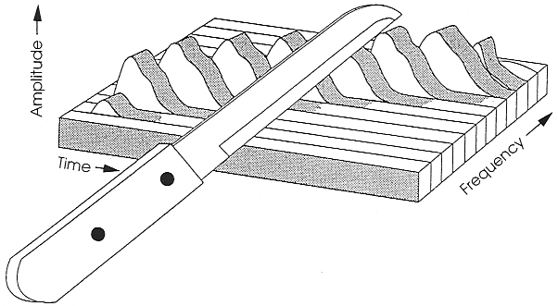
Spectrograms
Familiar signal representations can be found within spectrograms
A “slice” across time at a certain frequency represents the temporal variation in amplitude at a given frequency
  output of an individual filter in the filter bank
Whistle
Amplitude
Time
A “slice” across frequency at a certain time represents the spectral variation at a given point in time
  Short-term spectrum
Amplitude
Frequency

Slide 6
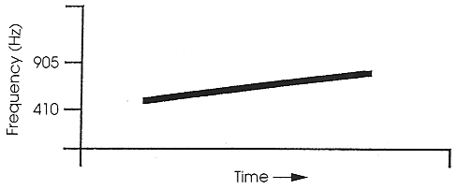
Spectrograms in 2-dimension
Spectrograms are 3-D (amplitude, frequency, time)
However, they are often represented in 2-D as
  Frequency versus time
  Amplitude is represented by
    Darkness (high amplitude ➔ darker)
    Color (e.g., low amplitude ➔ Blue, high amplitude ➔ Red )

Slide 7
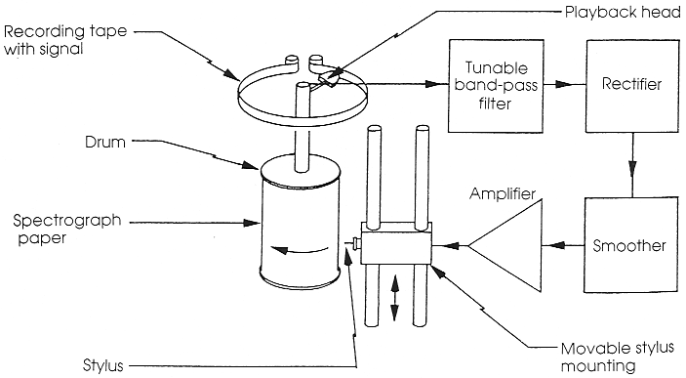
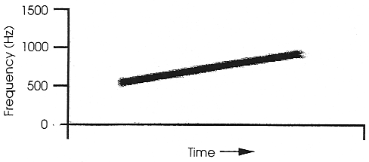
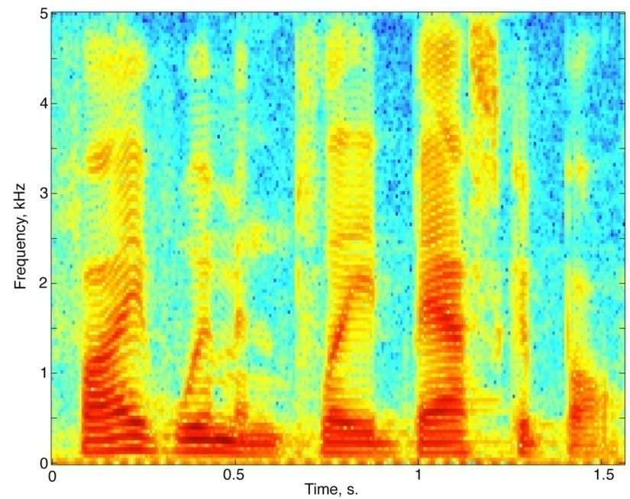
Computers have made spectrograms much easier
Spectrograms used to be made with spectrographs
  Drum
  Tunable filter
  Rectification and smoothing
  Output: one drum rotation for each frequency; amplitude as darkness
Now, computers are fast enough that multiple Fast Fourier Transforms (FFTs) can be computed to create a detailed color plot

Slide 8
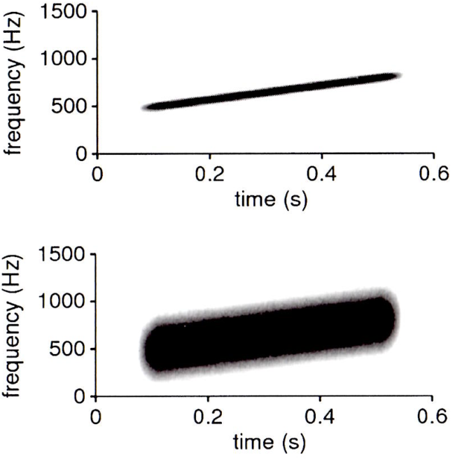
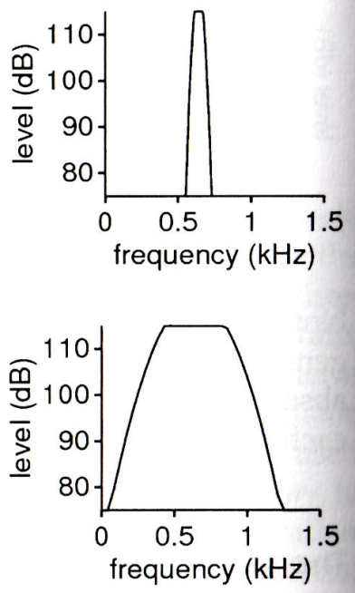
The choice of filter bandwidth
For speech,
  45 Hz (narrow) is about the smallest filter bandwidth that is useful
    Good resolution in frequency
    Poor resolution in time
  300 Hz (wide) can also be used
    Good resolution in time
    Poor resolution in frequency (smearing information across frequency)
Different tasks call for different bandwidths
Narrow band
Wide band

Slide 9
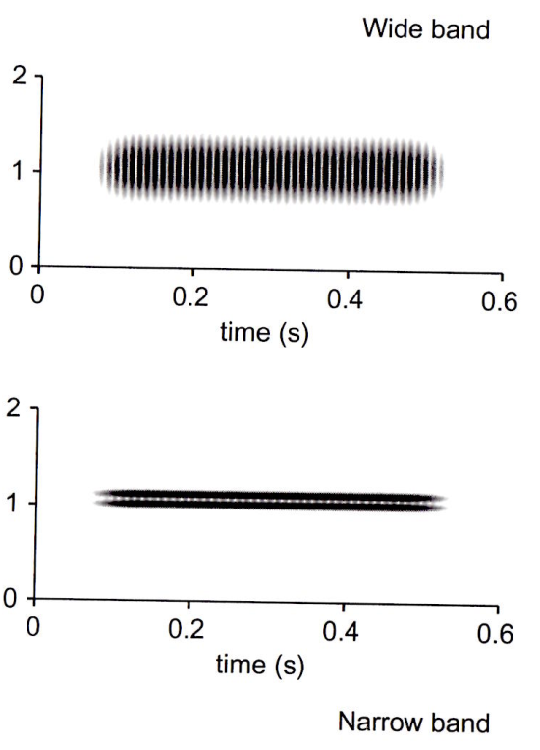
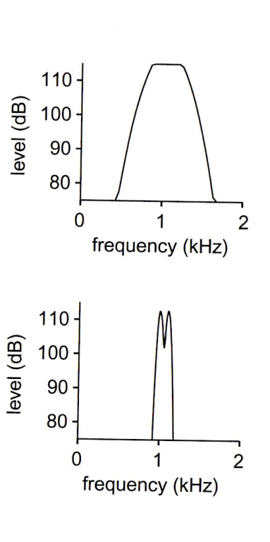
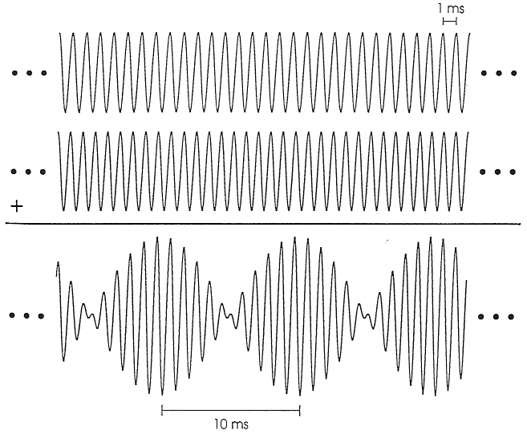
Resolving two tones spaced closely in frequency
The wide-band (300-Hz) filters do not resolve the two components (1000 and 1100 Hz) , whereas the narrow-band (45-Hz) filters do show both tones.
Note the temporal patterning in the wide-band spectrogram
These “beats” occur because both tones fall within single filters and interact with each other to produce 100-Hz modulations in the complex waveform (i.e., 100-Hz beats)
No beats occur when only single tones fall within single (NB) filters

Slide 10
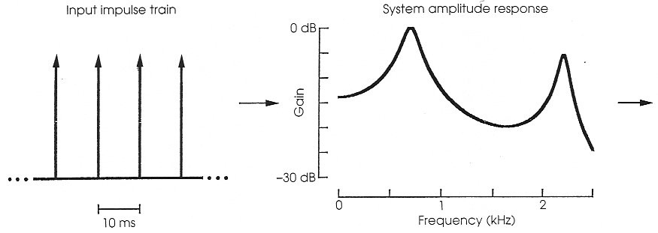
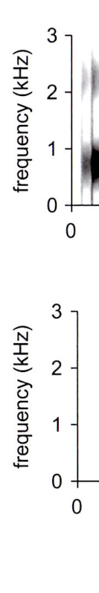
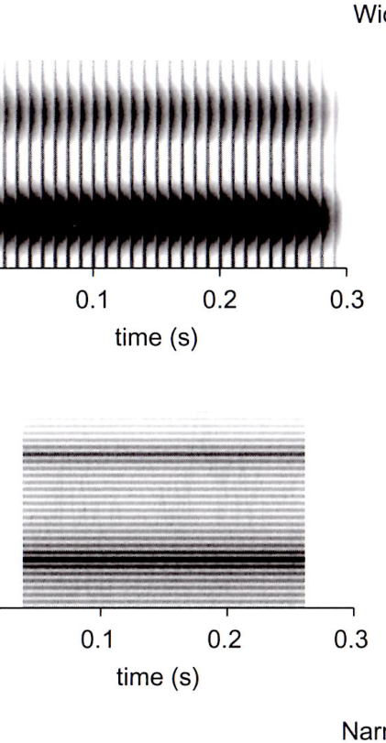
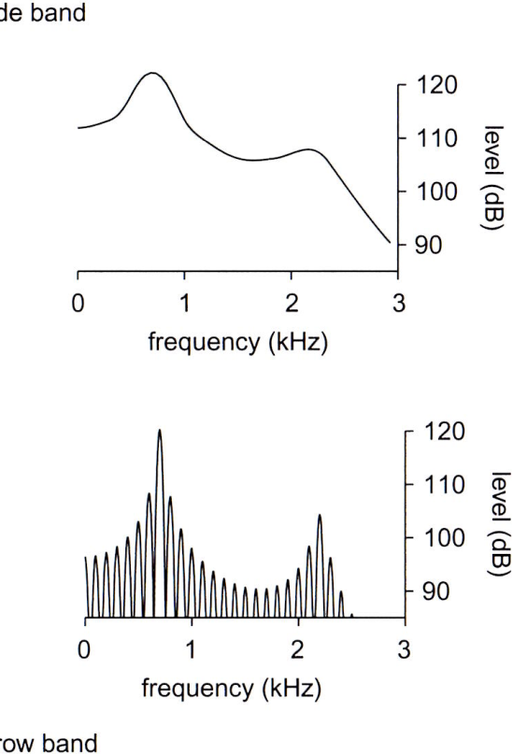
Harmonic spectra with resonances (of vowels)
Narrow-band spectrogram
  Shows each harmonic
  Shows formants
Wide-band spectrogram
  Shows each pulse
  Shows formants
Both NB and WB show formants
  both BWs are small relative to formant separation
WB spectrograms often used for speech
  they show both temporal structures and spectral envelope
  don’t show harmonics

Slide 11
Practical issues with spectrograms
Natural speech rolls off at high frequencies (e.g., sawtooth is - 6dB/oct)
  Sometimes an equalizing filter (high-pass) is used to place all frequencies within the same limited dynamic range
This solution corrupts overall amplitude, but the “where” and “when” information most typically used to analyze speech is visually maintained
Spectrographs (e.g., drums, as in text) are mostly obsolete (except museums)
Computer-generated spectrograms are now used
  Computed very differently
  Appearance is very similar
  Similar issues arise in terms of spectral/temporal tradeoffs in analysis
  We’ll use MATLAB!

Slide 12
Demos/functions
  SpectrogramDemo.m
    spectrogram_BW_DR.m (Introduction of the STFT method)

